Slide 1
XSL-Mapping Example
Name Referent
Title/ Function
Corporate Customer & Enterprise Integration
Date

Slide 2
To approaches:
„Design by contract“-approach
„Code first“-approach

Slide 3
Two approaches
„Design by contract“-approach
This approach is the more academical approach.
Analyse the structure of the source and target
Identify patterns and templates
Create templates or use matching templates
Create a master-template which uses the other templates

Slide 4
Two approaches
„Code first“-approach: This approach is the more simple / practical approach.
Write the code in the result xml:
write your own xml
use a XSD to create an xml example file
use a given example file

Slide 5
Two approaches
„Code first“-approach: This approach is the more simple / practical approach.
Write the code in the result xml:
write your own xml
use a XSD to create an xml example file
use a given example file
IMHO: the 3rd way is quick and simple, easy to understand and can also be extended…

Slide 6
Two approaches
Which way to choose
We use the simple way because:
We want to have one file per mapping because versioning is a cruel with many templates
It‘s very likley that there are only a few cases where we can reuse whole templates
If we are at a point to use SGI than think about the OSB
KEEP IT SIMPLE ➔ a plain written template is not very useful, but it‘s easy to read and to understand so we ensure good maintainability
No dependencies

Slide 7
Examle XSL
Workflow
we have to put the target content to the xsl main template
Take a look at the namespaces used
map the needed data to the document
(Maybe extend the document)
(Consider using templates / variables)
(Cleanup)
Done!

Slide 8
Example XSL
we have to put the target content to the xsl main template
<?xml version="1.0" encoding="UTF-8"?>
<xsl:stylesheet version="2.0" xmlns:xsl="http://www.w3.org/1999/XSL/Transform" xmlns:xsi="http://www.w3.org/2001/XMLSchema-instance">
<xsl:output method="xml" version="1.0" encoding="UTF-8" indent="yes"/>
<xsl:template match="/">
Your content goes here!
</xsl:template>
</xsl:stylesheet>

Slide 9
Example XSL
we have to put the target content to the xsl main template
<?xml version="1.0" encoding="UTF-8"?>
<xsl:stylesheet version="2.0" xmlns:xsl="http://www.w3.org/1999/XSL/Transform" xmlns:xsi="http://www.w3.org/2001/XMLSchema-instance">
<xsl:output method="xml" version="1.0" encoding="UTF-8" indent="yes"/>
<xsl:template match="/">
<Calls>
<Call>
....
....
....
</Call>
</Calls>
</xsl:template>
</xsl:stylesheet>

Slide 10
Example XSL
2. Take a look to the namespaces used

Slide 11
Example XSL
2. Take a look to the namespaces used
<?xml version="1.0" encoding="UTF-8"?>
<xsl:stylesheet version="2.0" xmlns:xsl="http://www.w3.org/1999/XSL/Transform" xmlns:xsi="http://www.w3.org/2001/XMLSchema-instance" xmlns="http://im.se/wms/webservices/">
<xsl:output method="xml" version="1.0" encoding="UTF-8" indent="yes"/>
<xsl:template match="/">
<Calls>
<Call>
....
....
....
</Call>
</Calls>
</xsl:template>
</xsl:stylesheet

Slide 12
Example XSL
3. map the needed data to the document
<xsl:stylesheet version="2.0" xmlns:xsl="http://www.w3.org/1999/XSL/Transform" xmlns:xsi="http://www.w3.org/2001/XMLSchema-instance" xmlns="http://im.se/wms/webservices/">
<xsl:output method="xml" version="1.0" encoding="UTF-8" indent="yes"/>
<xsl:template match="/">
<Calls>
<Call>
<Partys>
<Party>
<ChannelId>
<xsl:choose>
<xsl:when test="/ExchDocument/DeliveryOrder/Order/ClientId = 'TFNTRADING'">SLV_TFNTRADING</xsl:when>
<xsl:when test="/ExchDocument/DeliveryOrder/Order/ClientId = 'WINARDENTE'">SLV_WINARDENTE</xsl:when>
</xsl:choose>
<ChannelId>

Slide 13
Example XSL
4. Consider using templates / variables
<xsl:stylesheet version="2.0" xmlns:xsl="http://www.w3.org/1999/XSL/Transform" xmlns:xsi="http://www.w3.org/2001/XMLSchema-instance" xmlns="http://im.se/wms/webservices/">
<xsl:output method="xml" version="1.0" encoding="UTF-8" indent="yes"/>
<xsl:template match="/">
<xsl:variable name="TransactionId" select="concat('P',format-dateTime(current-dateTime(),'[Y0001][M01][D01][H01][m01][s01][f001]'))"/>
<Calls>
<Call>
<Partys>
<Party>
<ChannelId>
<xsl:choose>
<xsl:when test="/ExchDocument/DeliveryOrder/Order/ClientId = 'TFNTRADING'">SLV_TFNTRADING</xsl:when>
<xsl:when test="/ExchDocument/DeliveryOrder/Order/ClientId = 'WINARDENTE'">SLV_WINARDENTE</xsl:when>
</xsl:choose>
<ChannelId>

Slide 14
Examle XSL
Workflow
we have to put the target content to the xsl main template
Take a look to the namespaces used
map the needed data to the document
(Maybe extend the document)
(Consider using templates / variables)
(Cleanup)
Done!
Depends on the mapping

Slide 15
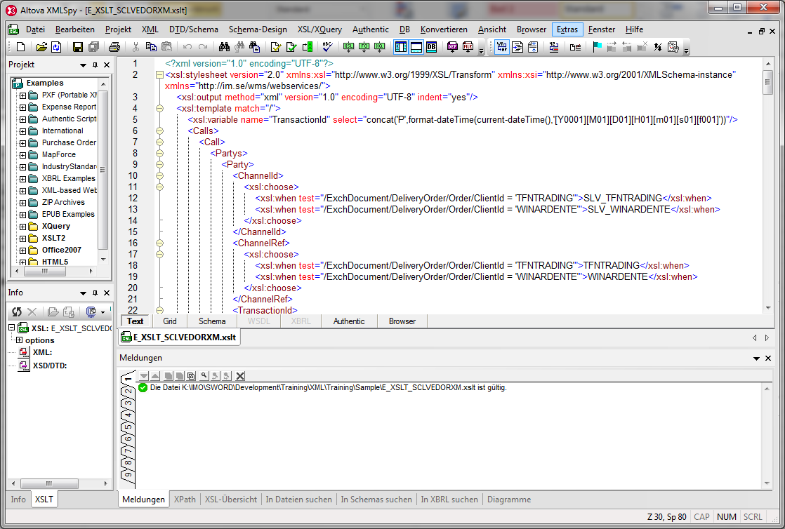
Work with XML-Spy
Work with XMLSpy

Slide 16
Work with XML-Spy
Work with XMLSpy
stylesheet
Validation
result

Slide 17
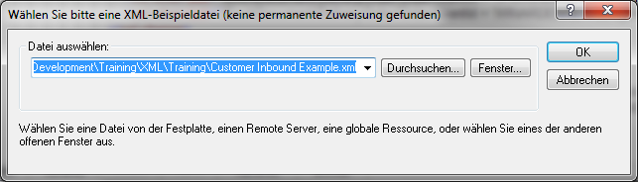
Work with XML-Spy
Work with XMLSpy
F10: select a source XML:

Slide 18
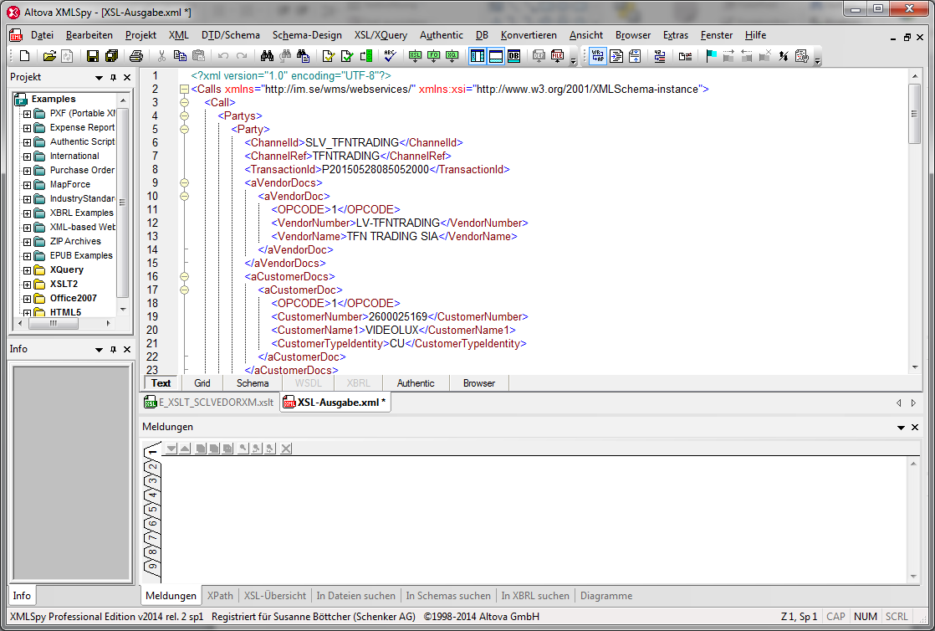
Work with XML-Spy
Work with XMLSpy
Generated output:

Slide 19
Limitations
Limitations for use within XIB:
At this moment…
… we have to use a subhandler call to the processor
… it‘s not possible to give the BDID to the XSLT-Processor
… we can not access Datatables direct only indirect via xml-include
… the jvm is started and shutdown every time a document has to be processed
… we have no svn scripts to check-in the mappings

Slide 20
Limitations
Limitations for use within XIB:
In the future …
… we have a own MBC
… we will get the references and informations like BDID in the xml-stream
… we should get the direct access tot Datatables
… the processor runs as deamon
… we will have svn scripts to check-in the mappings

